Slide 1
Deep Learning Workbench

Slide 2
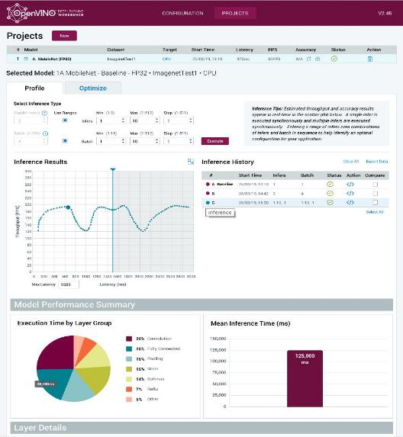
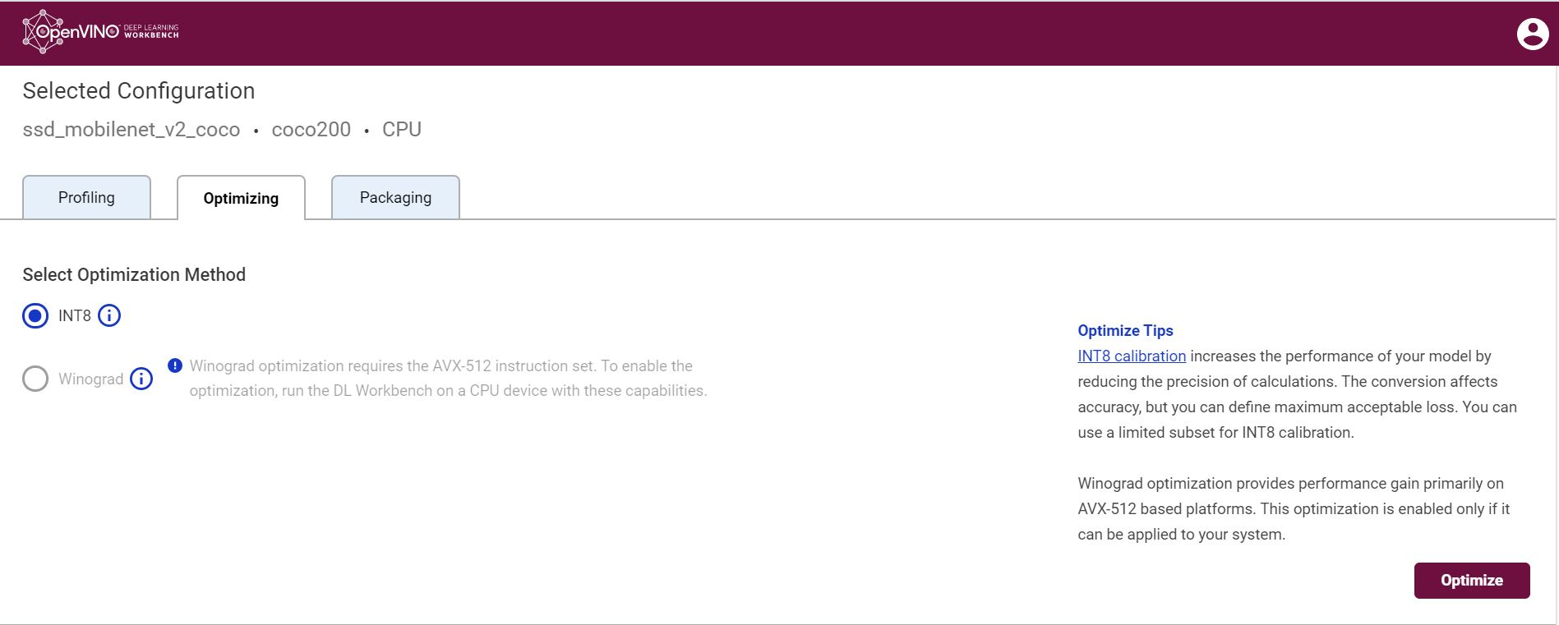
Deep Learning Workbench
Web-based, UI extension tool of the Intel® Distribution of OpenVINO™ toolkit
Visualizes performance data for topologies and layers to aid in model analysis
Automates analysis for optimal performance configuration (streams, batches, latency)
Experiment with INT8 or Winograd calibration for optimal tuning using the Post Training Optimization Tool
Provide accuracy information through accuracy checker
Direct access to models from public set of Open Model Zoo
Enables remote profiling, allowing the collection of performance data from multiple different machines without any additional set-up.
Development Guide  https://docs.openvinotoolkit.org/latest/_docs_Workbench_DG_Introduction.html
Copyright © 2020, Intel Corporation. All rights reserved.
Notes:
The DL workbench is a web-based graphical environment that enables users to visualize, fine-tune, and compare the performance of deep learning models on various Intel® architecture configurations, such as CPU, Intel® Processor Graphics (GPU), Intel® Movidius™ Neural Compute Stick 2 (NCS 2), and Intel® Vision Accelerator Design with Intel® Movidius™ VPUs, we will walk you through a demo of DL workbench later.
DL Workbench is a docker container application, users can either build the local docker image by running the "build script" with the path of the OpenVINO toolkit installation package or install it with the docker hub image named "openvino/workbench". After successfully installed DL Workbench, a http://127.0.0.1:5665 link followed by a generated token will appear in the console log, then you can open it in the browser, you will see the graphical interface as we showed here on the page.
Then you can import and convert a model to FP32 or FP16, then compare the visualized original and converted model, browse performance data of each layer of this model, and benchmark the performance by applying the combination of different batch sizes and inference requests to check which one satisfies your need most. Or, you can convert a model to the INT8 data type and check and control the accuracy loss during the conversion. Finally, you can export a deployment package with the model IR files and associated dependencies.

Slide 3
Deep Learning Workbench Data Flow
STEP 0: Train model with FW (Out-of-scope for Intel® Deep Learning Deployment Toolkit) | STEP 1: Convert model to IR file with use of Model Optimizer | STEP 2: Import Intermediate Representation (IR) file & dataset - then conduct multiple performance experiments | STEP 3: Deploy application
Model Downloader
Deep Learning Workbench
(emulating single NN application)
Model Optimizer
Post-training Optimization
Model Analyzer
Benchmark App
Trained
Model
IR
Accuracy Checker
Deployment Manager
Data
Set
Inference Engine
IR = Intermediate Representation file
Notes:
Here’s the block diagram view of the DL Workbench dataflow.
Step0, you either have a pre-trained model, or import one from Open Model Zoo using the Model Downloader at the backend;
Step1: Use the Model Optimizer at the backend to convert the model to IR format, then if you would like to run the accuracy check, or prepare to convert the model to INT8 datatype later, you will need to upload a real dataset, otherwise you can generate a random dataset here;
After Step1, DL Workbench will run a basic inference, after that the Model Analyzer will list out the static information of this model;
then in Step2, you can either select a range of the batch sizes and inference requests numbers, and the backend Benchmark App will start to run all the combinations of these two parameters, and draw their performance on the chart,
or you can check the accuracy of the model with the dataset you uploaded in Step1, Accuracy Checker will handle that for you, and furthermore, you can specify a method to convert the model to a INT8 datatype with the Post-Training Optimization Toolkit support,
and at the end you can export the deployment package by using Deployment Manager.
Note here, not all the models support the dataflow shown here, so if the model does not work well with DL Workbench, then you will need to run the tools behind DL Workbench directly in the command-line environment, which provide more flexibility.

Slide 4
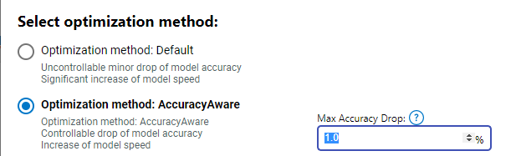
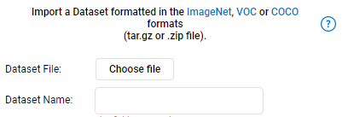
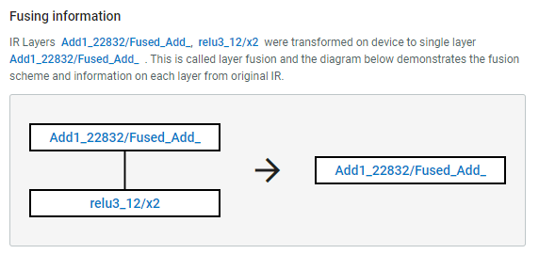
convert model to Int8 using 2 new calibration algorithms import dataset in COCO format to use with model Improved per-layer data visualization and comparison mode.
Deep Learning Workbench : FEATURES
Notes:
This page shows two methods to convert a model to INT8. It can either convert as many layers as it can to INT8 without controlling the accuracy loss, this method runs faster but had a higher accuracy drop as a result; or, you can set the accuracy drop percentage that you can bear with, then the post-training optimization tool will take that into account.

Slide 5
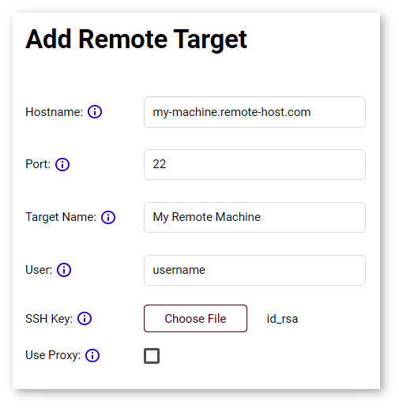
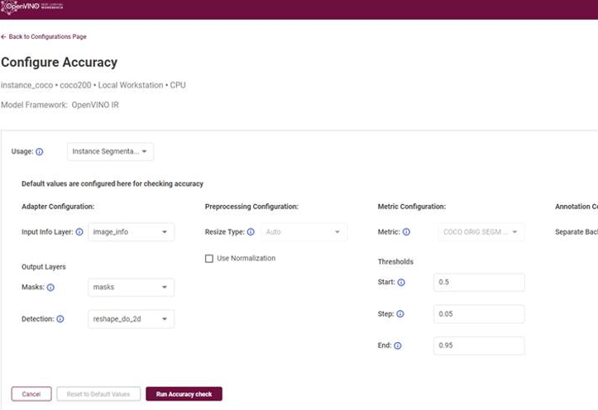
Remote profiling support
Deep Learning Workbench : NEW FEATURES
Support for Segmentation use cases
Notes:
This page shows two methods to convert a model to INT8. It can either convert as many layers as it can to INT8 without controlling the accuracy loss, this method runs faster but had a higher accuracy drop as a result; or, you can set the accuracy drop percentage that you can bear with, then the post-training optimization tool will take that into account.

